Slide 1
FULL, FULL, FULL STACK
Jorge Barata
@neuralhacker

Slide 2
Web App

Slide 3
Web App
MVC
Design Patterns
UX
REST
Data Persistence

Slide 4
Host
Web Server
Web App
DBMS

Slide 5
Shipping
Version Control
Unit Tests
Integration Tests
E2E Tests
Automated Deployment

Slide 6
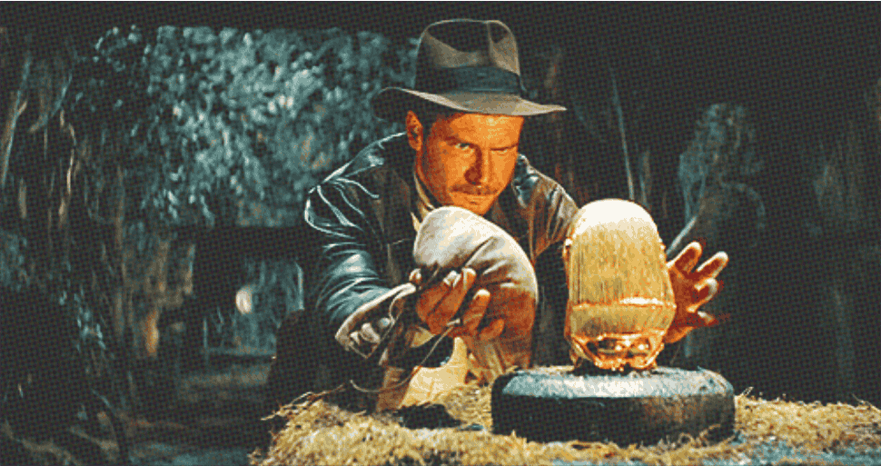
Zero Downtime

Slide 7
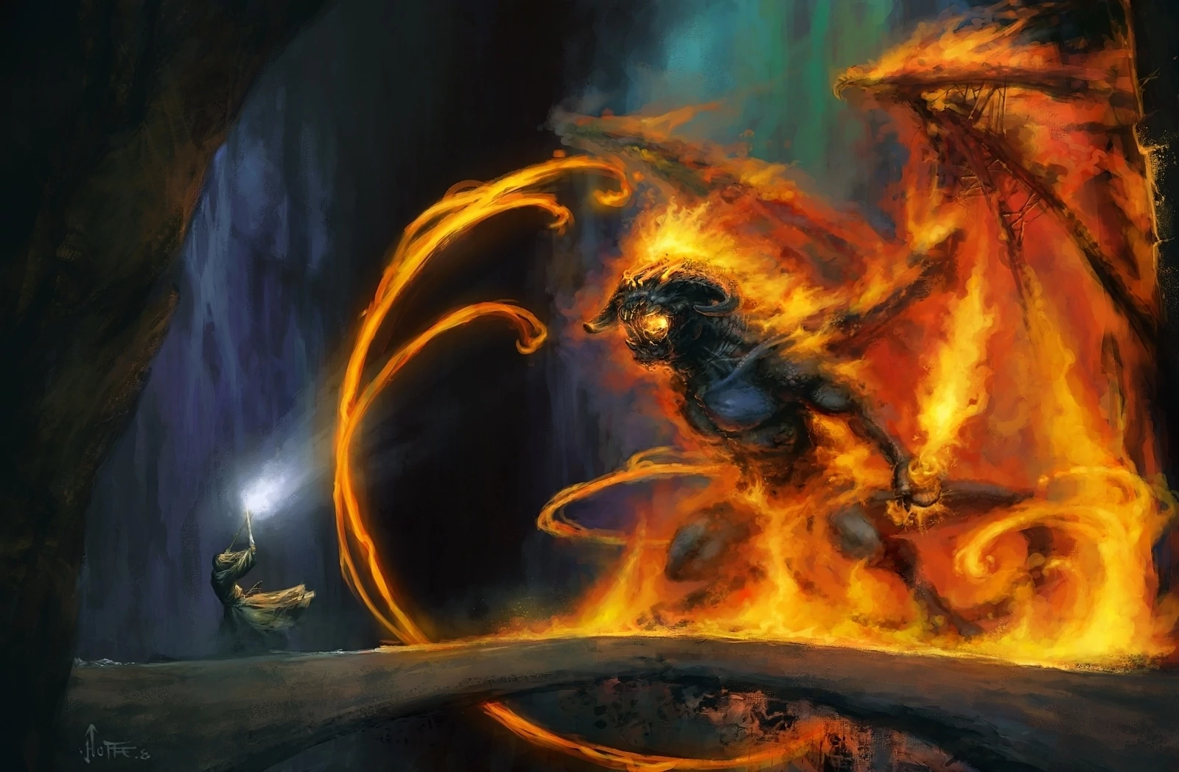
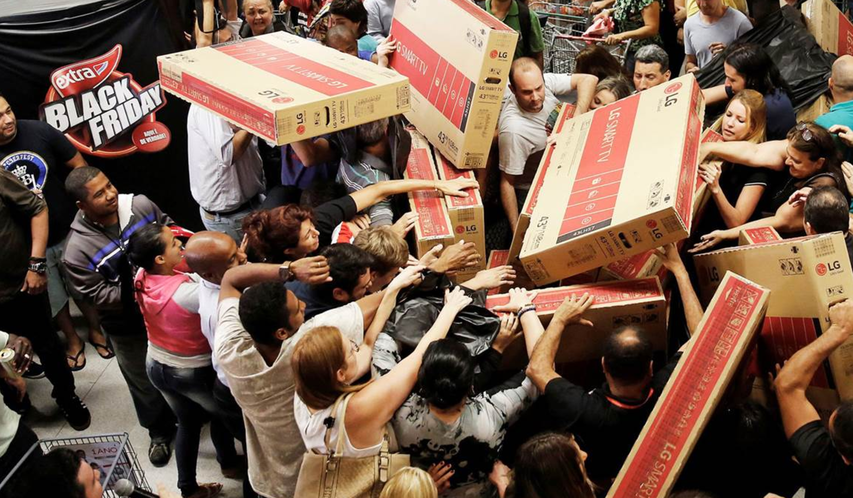
Zero Downtime
Processes
I/O
Memory
Daemons
Zombies

Slide 8
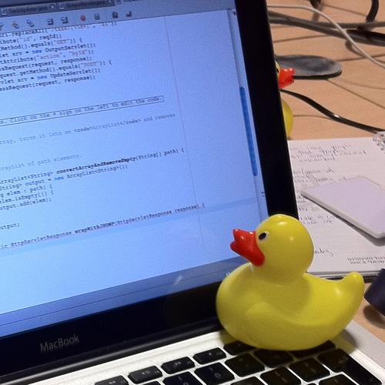
Monitoring & Debugging
Instrumentalization
Metrics
Logging
Tracing
Debugging
Rubber Duck Debugging
Notes:
Run out of memory

Slide 9
Scale

Slide 10
Host
Web Server
Web App
DBMS

Slide 11
Load Balancer
Web Host 1
Web Host 2
Web Host 3
Web Server
Web Server
Web Server
Web App
Web App
Web App
Database

Slide 12
Zero Downtime

Slide 13
Networking
VPN
TCP/IP
Sockets
DNS

Slide 14
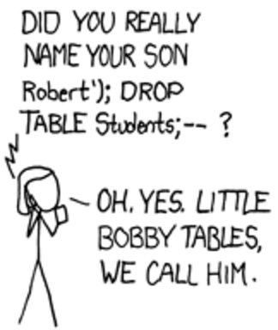
SECURITY
SSL
XSS
Penetration Tests
SQL Injection
...

Slide 15
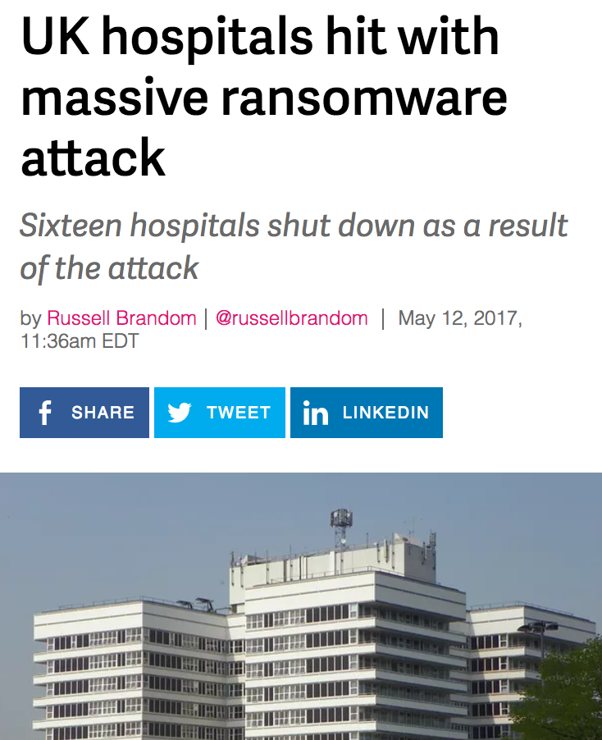
SECURITY
Robots
Isaac Asimov's
"Three Laws of Robotics"
Notes:
they have no mercy

Slide 16
SECURITY
Unattended Upgrades
iptables
fail2ban
Rate limiting
DDoS

Slide 17
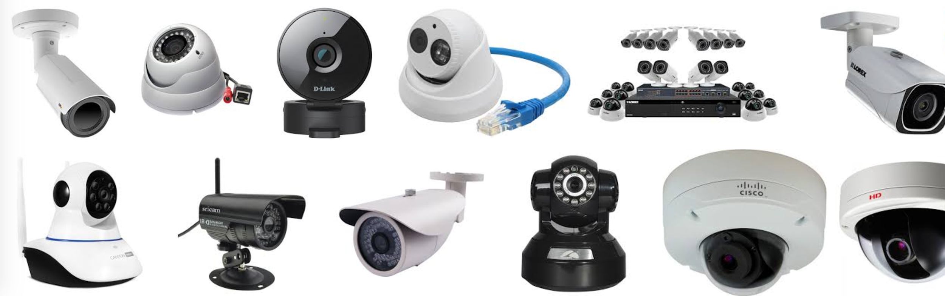
SECURITY

Slide 18
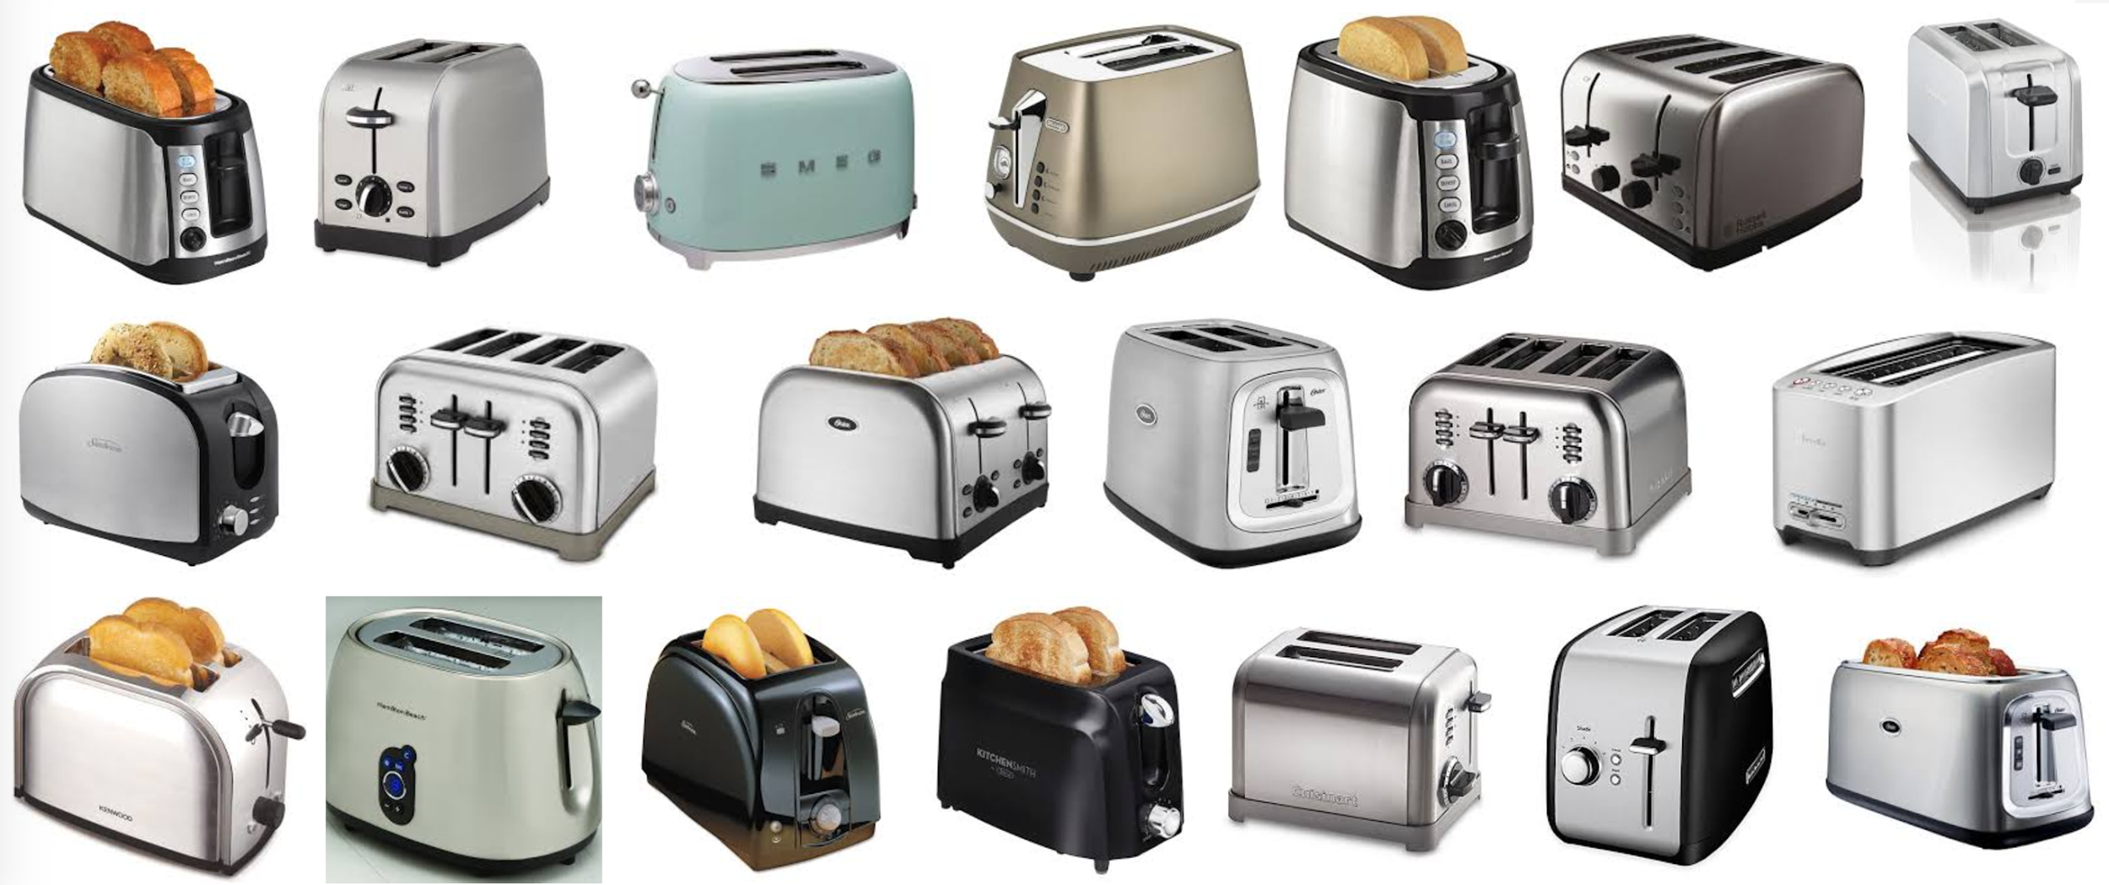
SECURITY

Slide 19

Continuous Integration
Humans
Branches
Merge Requests
Peer Reviews
Standards
Notes:
More people working you have to coordinate with

Slide 20

Who is this squirrel

Slide 21
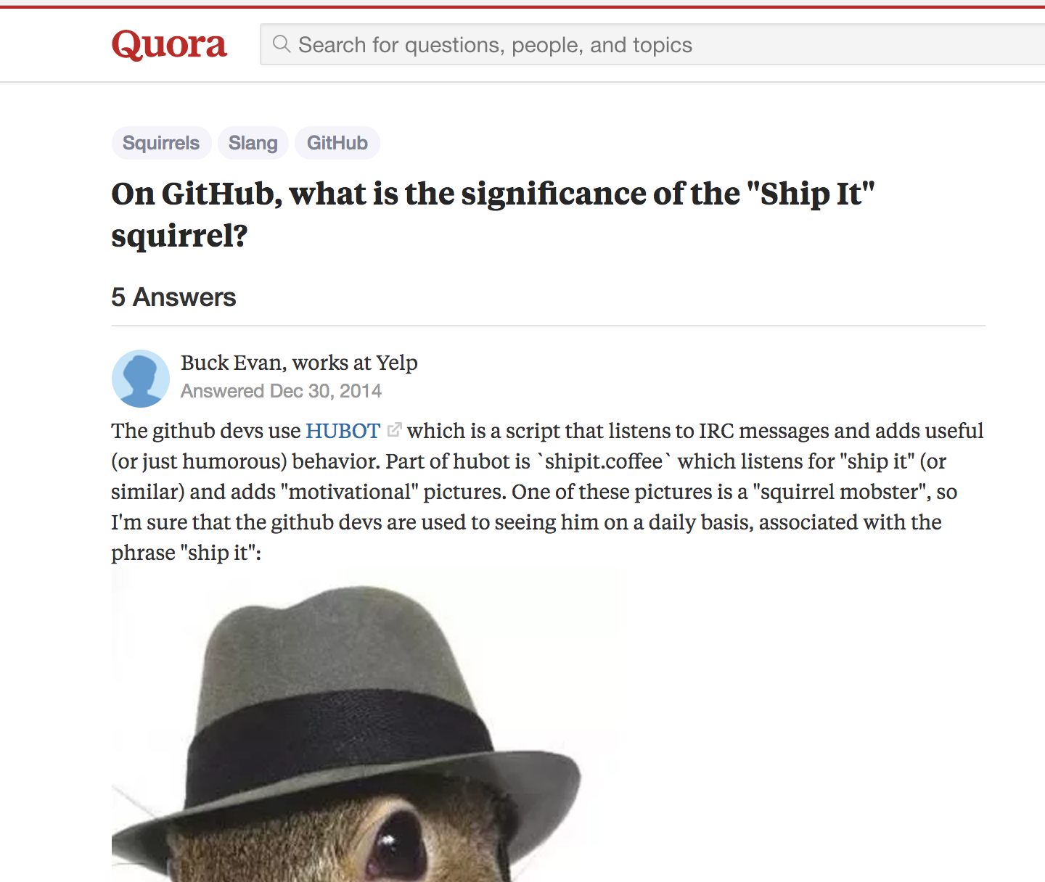

Slide 22
Load Balancer 1
Load Balancer 2
Web Host
Web Host
Web Host
Web Host
Web Host
Web Host
Web Host
Web Host
Web Host
Web Host
Web Host
Web Host
Web Host
Web Host
Web Host
Web Host
Web Host
Web Host
Web Host
Web Host
Web Host
Web Host
Web Host
Web Host
DB Master
DB Slave
DB Slave

Slide 23
Zero Downtime

Slide 24
Orchestration

Slide 25

Notes:
You can feel the power, this is how I feel when I see I can deploy hundreds of servers in seconds

Slide 26
The stack keeps growing
Mobile App
Mailing
Caching
Queues
CDN
Search Engine
Recommendation Engine
Machine Learning

Slide 27
Microservices

Slide 28
Load Balancer 1
Load Balancer 2
Web Host
Web Host
Web Host
Web Host
Web Host
Web Host
Web Host
Web Host
Web Host
Web Host
Web Host
Web Host
Web Host
Web Host
Web Host
Web Host
Web Host
Web Host
Web Host
Web Host
Web Host
Web Host
Web Host
Web Host
DB Master
DB Slave
DB Slave

Slide 29

Load Balancer 1
Load Balancer 2

Slide 31
Frontend

Slide 32







Frontend

Slide 33


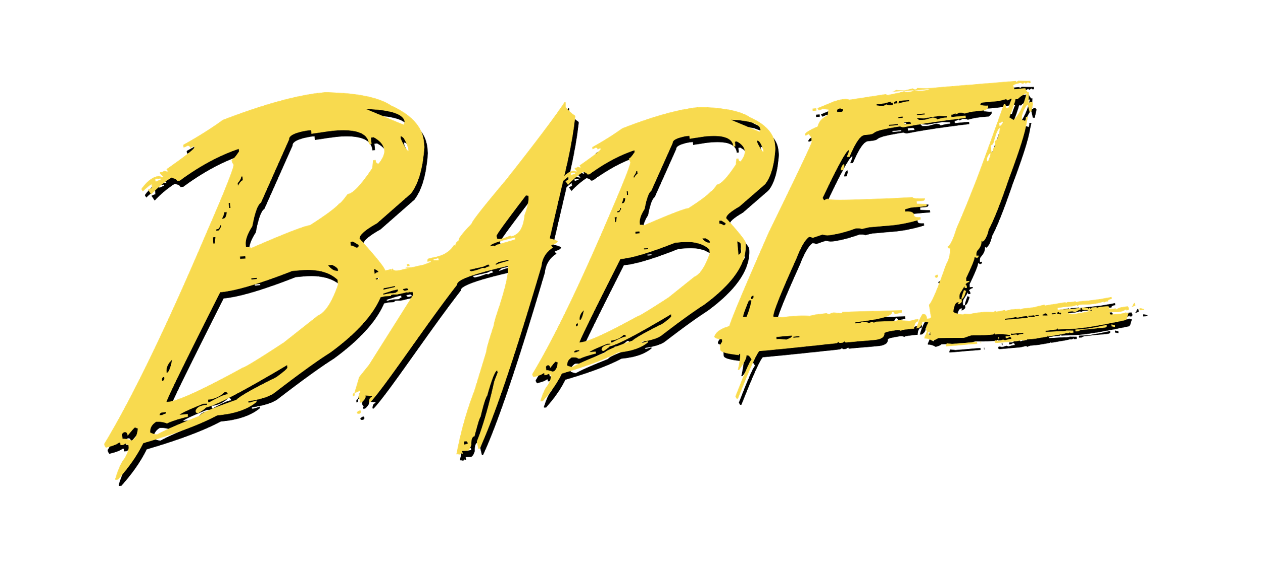





Frontend

Slide 34
Frontend
HTTP/2
Prefetching
Minimization
Compression
Tree Shaking
...
Notes:
Optimization

Slide 35

Frontend
HTTP/2
Prefetching
Minimization
Compression
Tree Shaking
...

Slide 36

Frontend
Notes:
full remote deployment of an completely autonomous robot

Slide 37
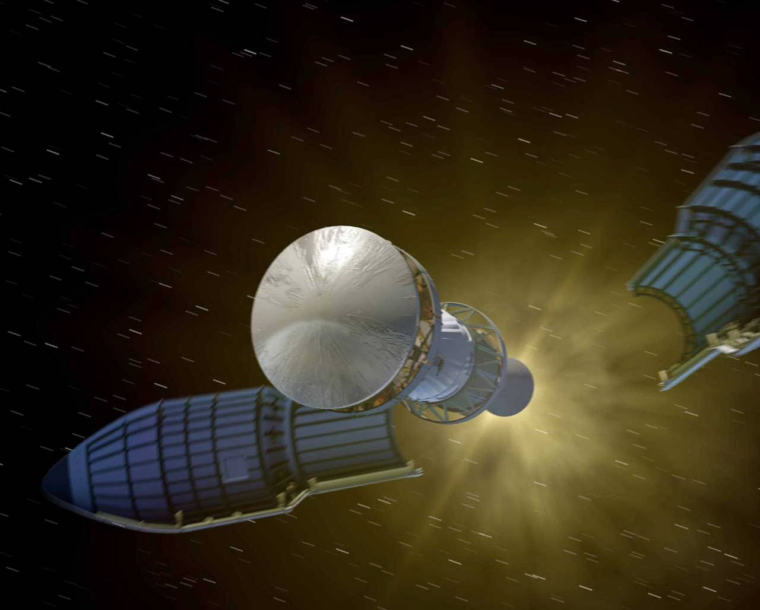
Frontend

Slide 38
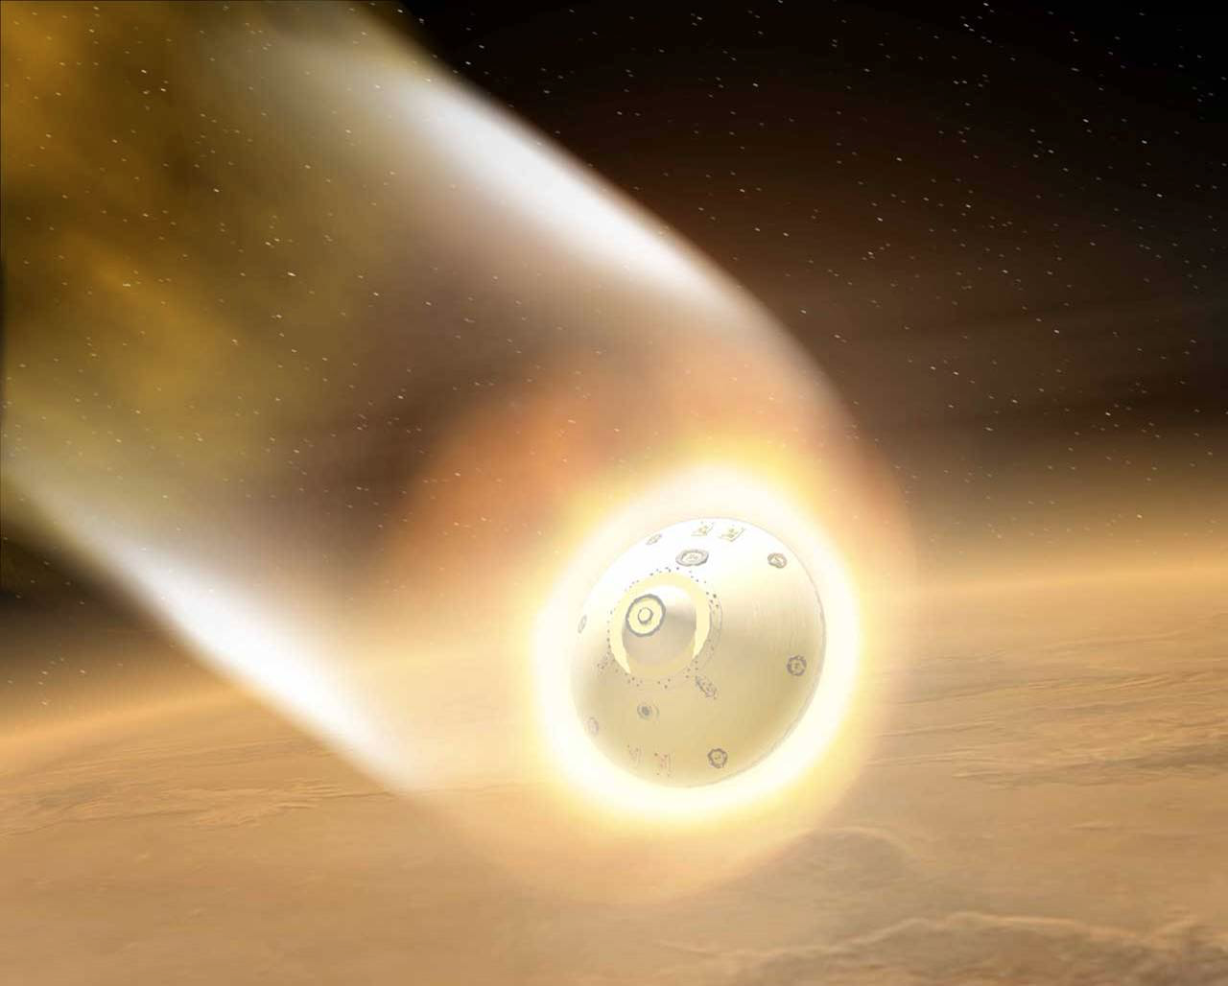
Frontend

Slide 39
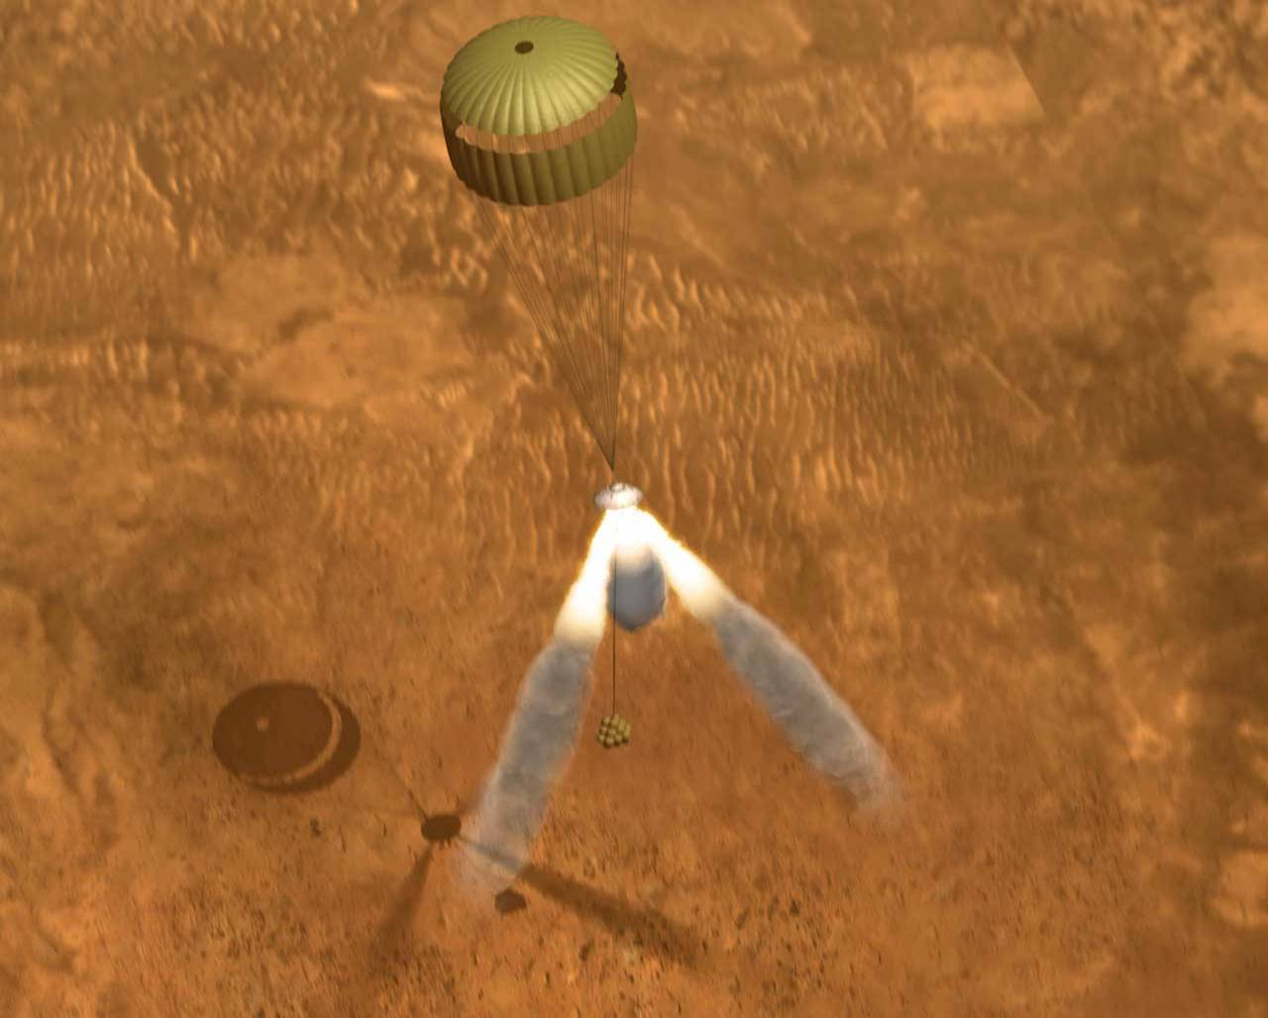
Frontend

Slide 40
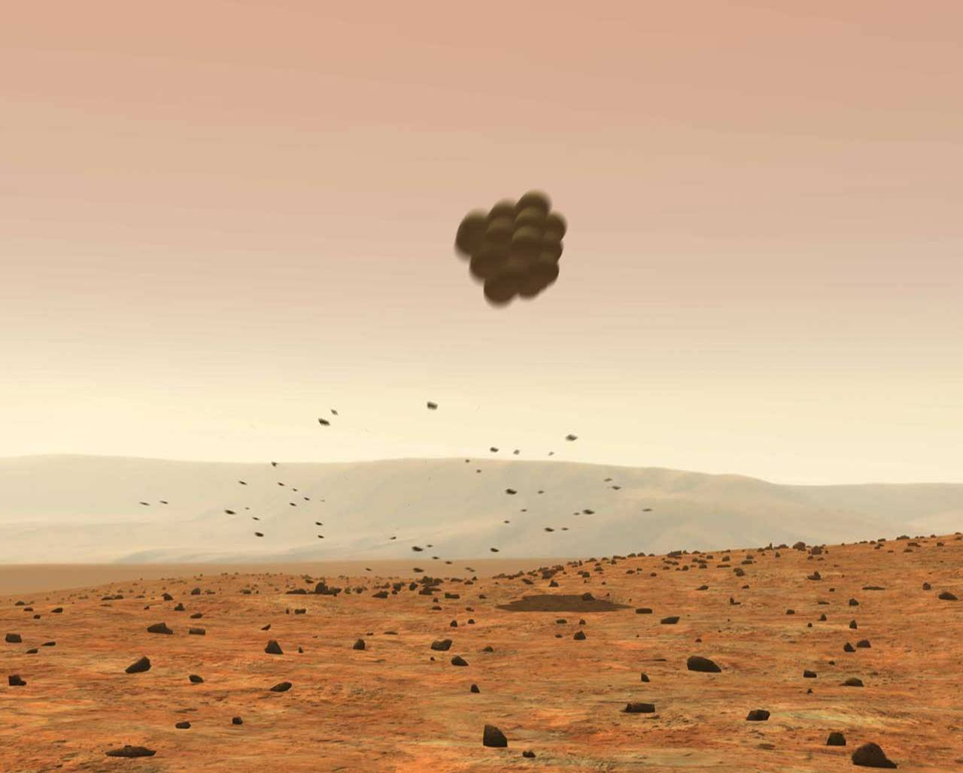
Frontend

Slide 41
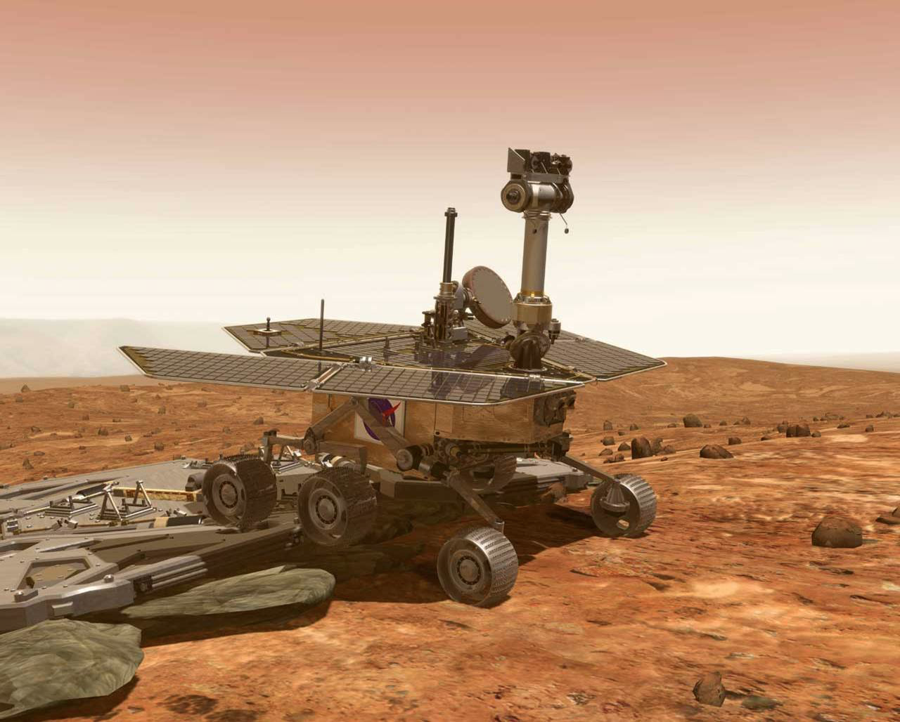
Frontend

Slide 43
Keep Learning
Notes:
The message

Slide 44











Pokémon Master
Notes:
you will feel like a pokemon master

Slide 45
Keep Learning!
Jorge Barata
@neuralhacker

